Slide 1
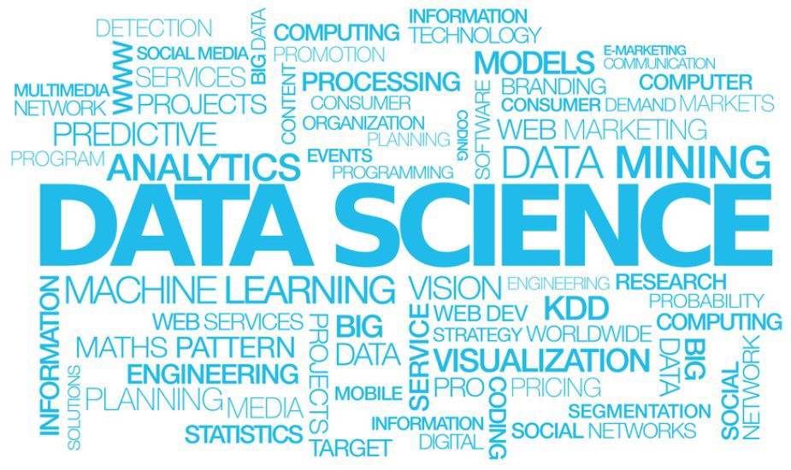
Presented By: SriVijaya Vani
Sepideh
Sarita
Sakina

Slide 2
Data Science skills
Data Cleaning
Exploratory Data Analysis
Interactive Data Visualizations
Machine Learning
Communication

Slide 3
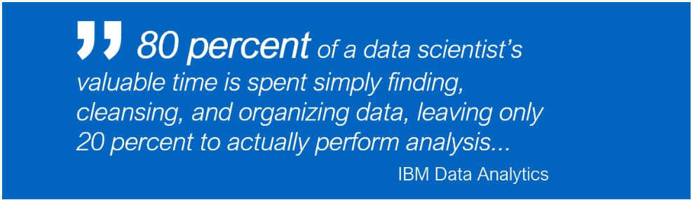
Data Cleaning
Data cleaning can be a tedious task.
It’s the start of a new project and you’re excited to apply some machine learning models.
You take a look at the data and quickly realize it’s an absolute mess.

Slide 4
Sources of Missing Values
Before we dive into code, it’s important to understand the sources of missing data. Here’s some typical reasons why data is missing:
User forgot to fill in a field.
Data was lost while transferring manually from a legacy database.
There was a programming error.
Users chose not to fill out a field tied to their beliefs about how the results would be used or interpreted

Slide 5
Getting Started
Before you start cleaning a data set, it’s a good idea to just get a general feel for the data. After that, you can put together a plan to clean the data.
I like to start by asking the following questions:
What are the features?
What are the expected types (int, float, string, boolean)?
Is there obvious missing data (values that Pandas can detect)?
Is there other types of missing data that’s not so obvious (can’t easily detect with Pandas)?

Slide 6
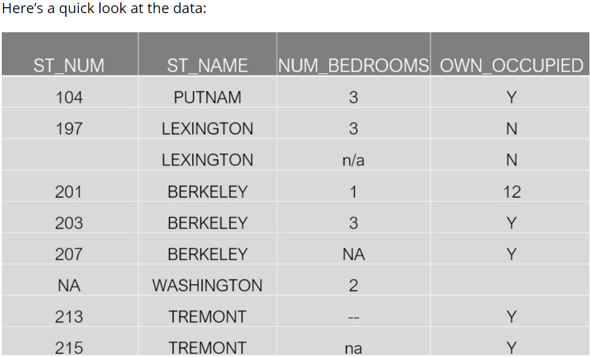
The data we’re going to work with is a very small real estate dataset.

Slide 7
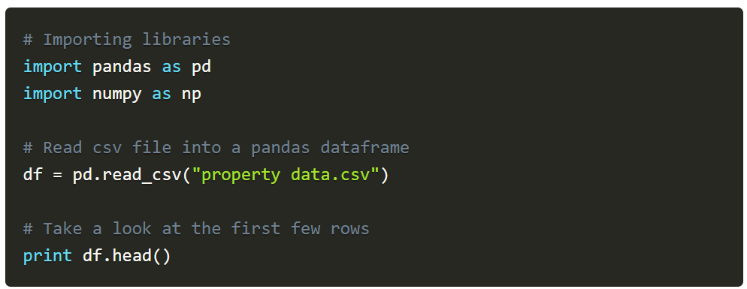
A good way to get a quick feel for the data is to take a look at the first few rows. Here’s how you would do that in Pandas:

Slide 8
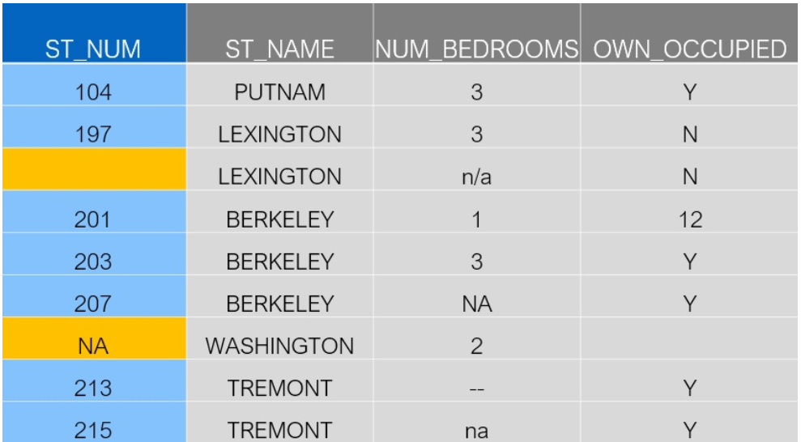
Standard Missing Values
So what do I mean by “standard missing values”? These are missing values that Pandas can detect.
Going back to our original data set, let’s take a look at the “Street Number” column.

Slide 9
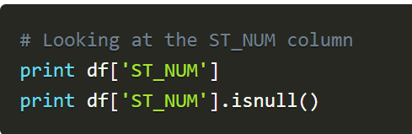
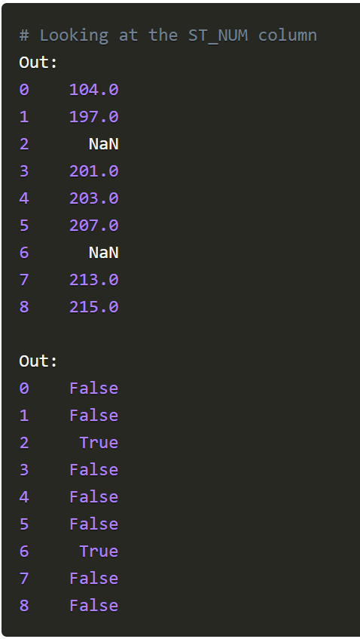
Let’s see how Pandas deals with these:
Taking a look at the column, we can see that Pandas filled in the blank space with “NA”. Using the isnull() method, we can confirm that both the missing value and “NA” were recognized as missing values. Both boolean responses are Tru

Slide 10
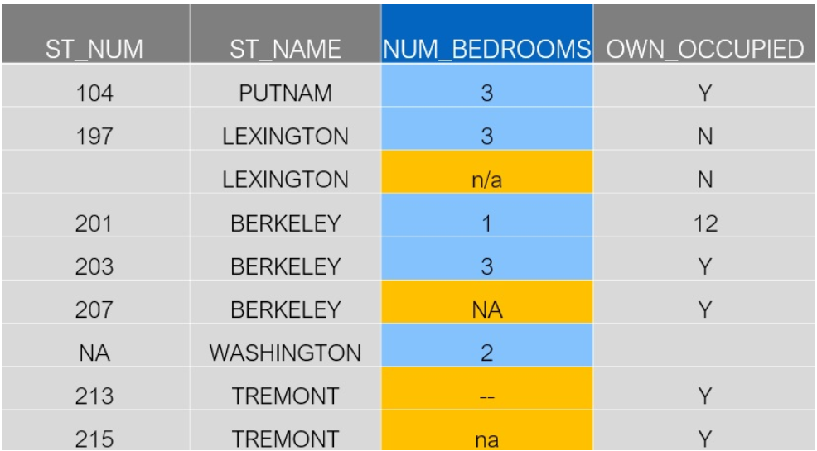
Non-Standard Missing Values
Sometimes it might be the case where there’s missing values that have different formats.
Let’s take a look at the “Number of Bedrooms” column to see what I mean.

Slide 11
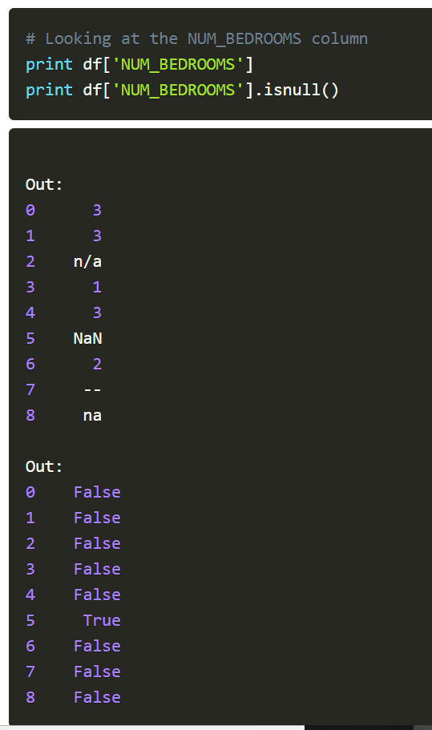
In this column, there’s four missing values.
n/a
NA
—
na
If there’s multiple users manually entering data, then this is a common problem. Maybe I like to use “n/a” but you like to use “na”..

Slide 12
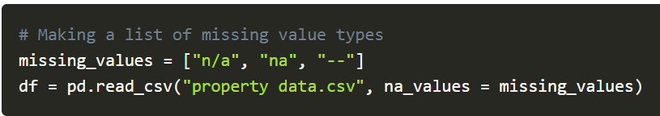
Here’s an example of how we would do that:
From the previous section, we know that Pandas will recognize “NA” as a missing value, but what about the others? Let’s take a look
Put various formats them in a list. Then when we import the data, Pandas will recognize them right away.

Slide 13
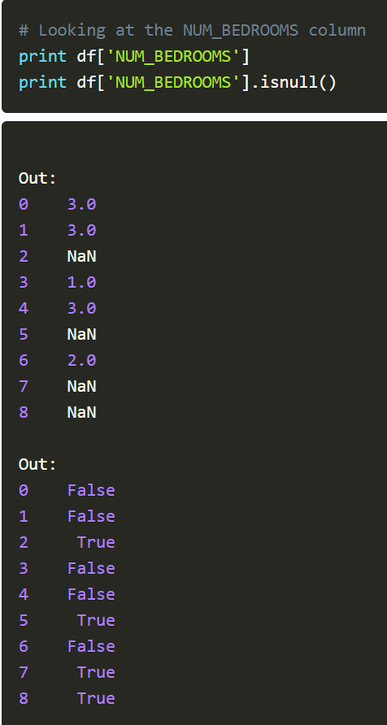
Now let’s take another look at this column and see what happens:

Slide 14
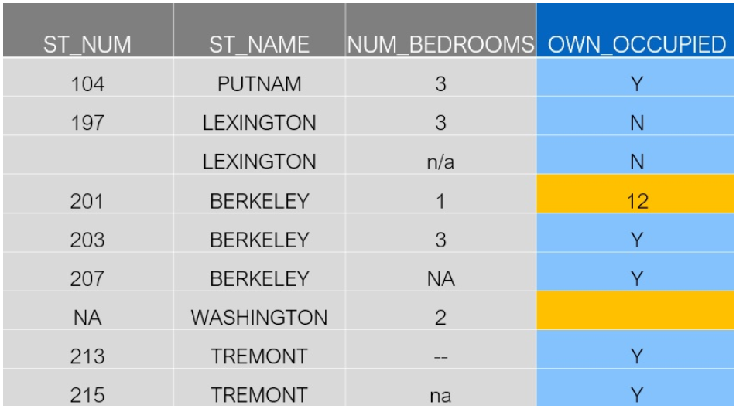
Unexpected Missing Values
So far we’ve seen standard missing values, and non-standard missing values. What if we an unexpected type?
For example, if our feature is expected to be a string, but there’s a numeric type, then technically this is also a missing value.
Let’s take a look at the “Owner Occupied” column to see what I’m talking about.

Slide 15
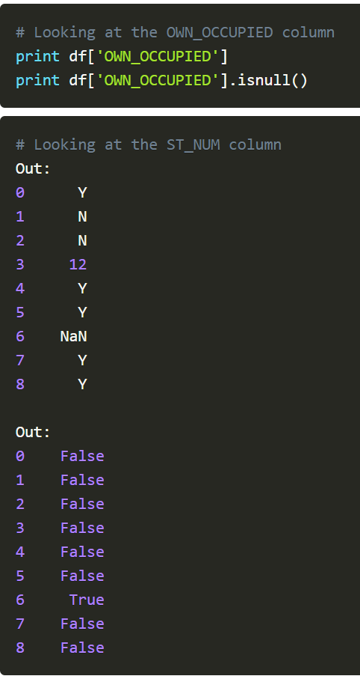
In the fourth row, there’s the number 12. The response for Owner Occupied should clearly be a string (Y or N), so this numeric type should be a missing value.

Slide 16
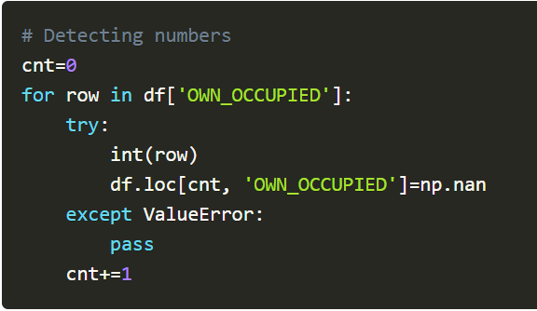
we’ll need to think through a strategy for detecting these types of missing values:

Slide 17
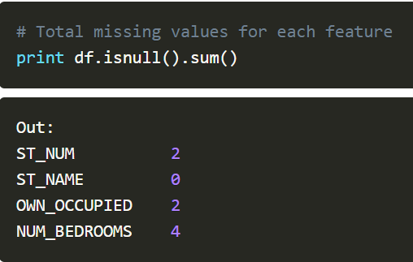
Summarizing Missing Values
After we’ve cleaned the missing values, we will probably want to summarize them.
For instance, we might want to look at the total number of missing values for each feature.

Slide 18
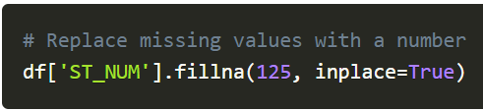
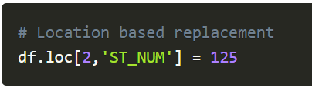
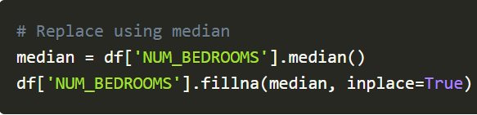
Replacing
Maybe you just want to fill in missing values with a single value.
More likely, you might want to do a location based imputation. Here’s how you would do that.
A very common way to replace missing values is using a median.

Slide 19
Conclusion
Dealing with messy data is inevitable. Data cleaning is just part of the process on a data science project.
sources:
https://www.dataoptimal.com/data-cleaning-with-python-2018/

Slide 20
Exploratory Data Analysis
Data Visualization is a big part of a data scientist’s jobs
Exploratory Data Analysis (EDA) to gain some insights into your data.
Creating visualizations really helps make things clearer and easier to understand, especially with larger, high dimensional datasets.
The process of organizing, plotting and summarising a dataset
EDA should not be neglected
It helps towards quantitative analysis
Towards the end of your project, it’s important to be able to present your final results in a clear, concise, and compelling manner that your audience, whom are often non-technical clients, can understand.

Slide 21
Popular plotting libraries
Matplotlib: low level, provides lots of freedom
Pandas Visualization: easy to use interface, built on Matplotlib
Seaborn: high-level interface, great default styles
Plotly: can create interactive plots

Slide 22
Scatter Plot
1. Correlation between two or more variables.
2. Dependent variable may have multiple values for each value of your independent variable.
3. It also helps it identify outliers, if any.
4. Positively , Negatively correlated and no correlation

Slide 23
Scatter Plot
import matplotlib.pyplot as plt
import pandas as pd
girls_grades = [89, 90, 70, 89, 100, 80, 90, 100, 80, 34]
boys_grades = [30, 29, 49, 48, 100, 48, 38, 45, 20, 30]
grades_range = [10, 20, 30, 40, 50, 60, 70, 80, 90, 100]
plt.scatter(grades_range, girls_grades, color='r')
plt.scatter(grades_range, boys_grades, color='g')
plt.xlabel('Grades Range')
plt.ylabel('Grades Scored')
plt.show()

Slide 24
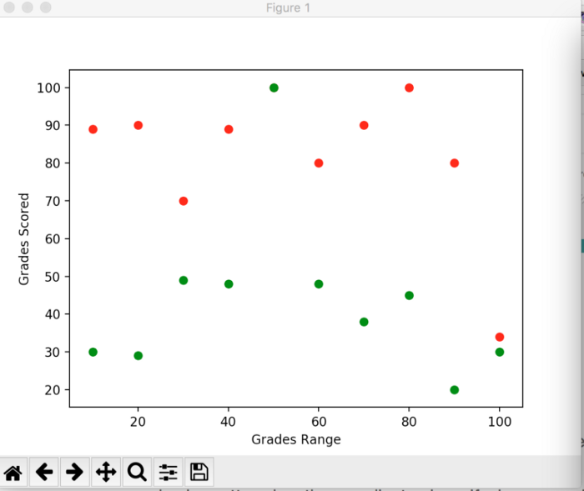
Scatter Plot

Slide 25
Line Plots
Displays information as a series of data points called ‘markers’ connected by straight line segments.
to check the trends

Slide 26
Line Plots
import matplotlib.pyplot as plt
year = [1960, 1970, 1980, 1990, 2000, 2010]
pop_pakistan = [44.91, 58.09, 78.07, 107.7, 138.5, 170.6]
pop_india = [449.48, 553.57, 696.783, 870.133, 1000.
4, 1309.1]
plt.plot(year, pop_pakistan, color='g')
plt.plot(year, pop_india, color='orange')
plt.xlabel('Countries')
plt.ylabel('Population in million')
plt.title('Pakistan India Population till 2010')
plt.show()

Slide 27
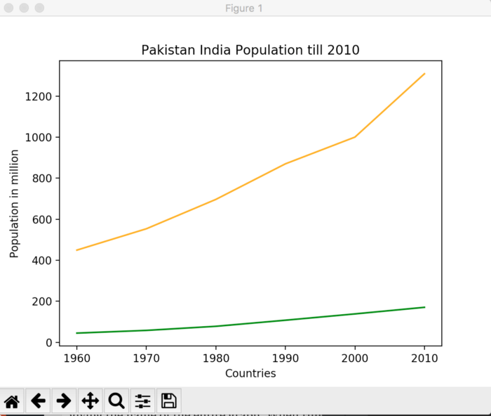
Line Plots

Slide 28
Histograms
provide a visual interpretation of numerical data by indicating the number of data points that lie within a range of values.
ranges of values are called classes or bins.
used to show distributions of variables
plot quantitative data with ranges of the data grouped into bins or intervals while bar charts plot categorical data.
histogram is an accurate graphical representation of the distribution of numerical data.
histograms are used to represent data given in form of some groups.

Slide 29
Histograms
d = pd.read_csv('runs.csv')
score_india = d['score_india']
legend = ['India', 'Pakistan']
score_pk = d['score_pk']
plt.hist([score_india, score_pk], color=['orange', 'green'])
plt.xlabel("Runs/Delivery")
plt.ylabel("Frequency")
plt.legend(legend)
plt.xticks(range(0, 7))
plt.yticks(range(1, 20))
plt.title('Champions Trophy 2017 Final\n Runs scored in 3 overs')
plt.show()

Slide 30
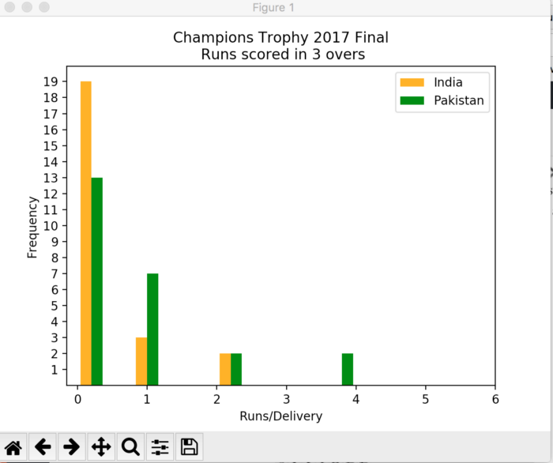

Slide 31
Bar Plots
A bar chart or bar graph is a chart or graph that presents categorical data with rectangular bars with heights or lengths proportional to the values that they represent. The bars can be plotted vertically or horizontally.

Slide 32
import matplotlib.pyplot as plt
import numpy as np
def plot_bar_x(label,no_movies):
# this is for plotting purpose
index = np.arange(len(label))
plt.bar(index, no_movies)
plt.xlabel('Genre', fontsize=5)
plt.ylabel('No of Movies', fontsize=5)
plt.xticks(index, label, fontsize=5, rotation=50)
plt.title('Market Share for Each Genre 1995-2017')
plt.show()
label= ['Drama','Adventure','Romance','Horror']
no_movies = [4000,100,2000,500]
plot_bar_x(label,no_movies)

Slide 33
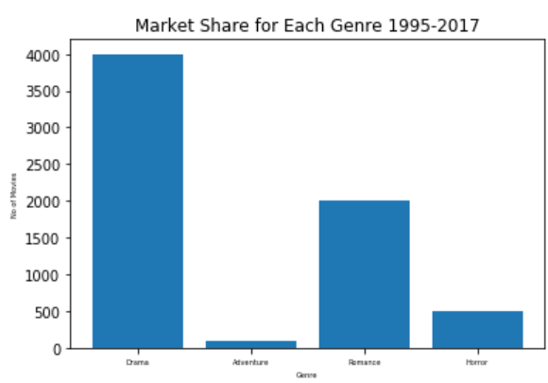
drawn to show the standard deviation.

Slide 34
Box Plots
Boxplots are a measure of how well distributed the data in a data set is. It divides the data set into three quartiles.

Slide 35
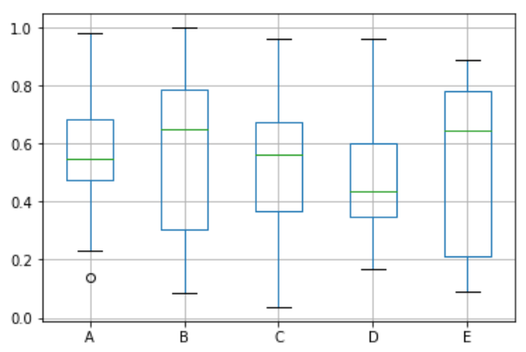
import pandas as pd
import numpy as np
df = pd.DataFrame(np.random.rand(10, 5), columns=['A', 'B', 'C', 'D', 'E'])
df.plot.box(grid='True')

Slide 36
Conclusion
There are your 5 quick and easy data visualisations using Matplotlib. Abstracting things into functions always makes your code easier to read and use!
Source:
https://towardsdatascience.com/5-quick-and-easy-data-visualizations-in-python-with-code-a2284bae952f
https://towardsdatascience.com/introduction-to-data-visualization-in-python-89a54c97fbed

